Slide 1
Car Price Prediction

Slide 2
Introduction
With the covid 19 impact in the market, we have seen lot of changes in the car market.
More Demand – Higher Price
New models are required to predict Price from new data.

Slide 3
Objective
Collect at least 5000 records from used car market.
Build a model using Machine Learning in order to predict the value of the used car at various locations.

Slide 4
Data Info
1
Let’s start with Data Pre-processing

Slide 5
Source | Number of Records Extracted | Number of Features
Cars24 | 4163 | 12
Olx | 486 | 15
CarDekho | 2570 | 17
Total | 7219 | 11
7219 Entries
10 Feature
1 Float, 2 Integer & 8 Categorical Features
The data has missing values which were dropped from the data set

Slide 6
Data Visualization – Univariate Analysis
2
Let’s start with our visualization on the dataset using Univariate Analysis Techniques

Slide 7
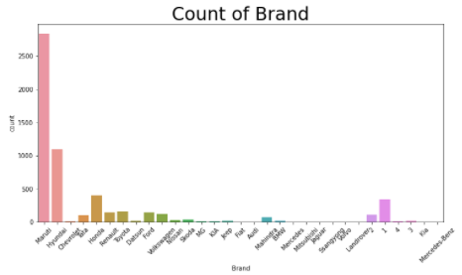
There are huge number of second hand cars of Maruti Suzuki, followed by Hyundai and Honda
The number cars are very less from Chevrolet and Datsun

Slide 8
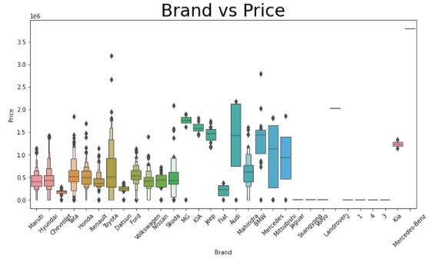
The price of the cars from the brand which is abundantly available lies in the same range.
Chevrolet is available at a cheap price.
The price of Honda and Tata are a little bit higher.

Slide 9
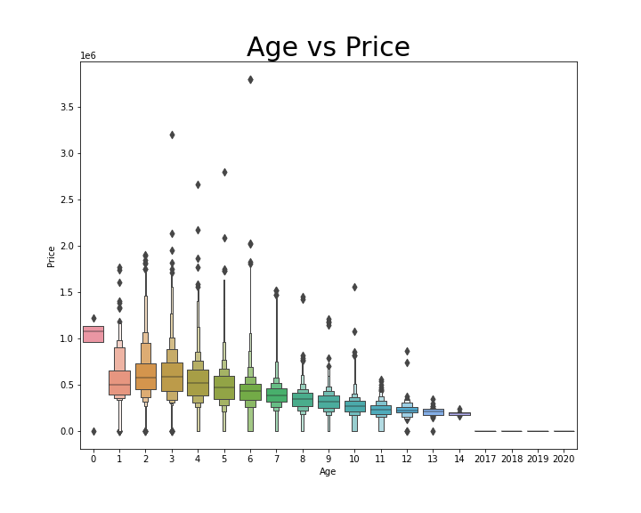
The price of the cars which are less than a year old are highest. At the same time the cars which are 2 or 3 years old are sold at a higher price than a car which has age 1 to 2 years.

Slide 10
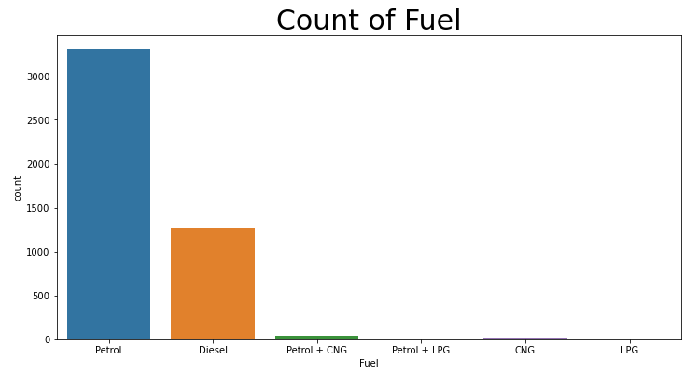
Most of the cars available for sale are from 2015 to 2018.
There are very less number of cars which run on CNG or LPG.

Slide 11
Feature Selection
3
Identification of highly corelated features using HeatMap and Select K Best Technique

Slide 12
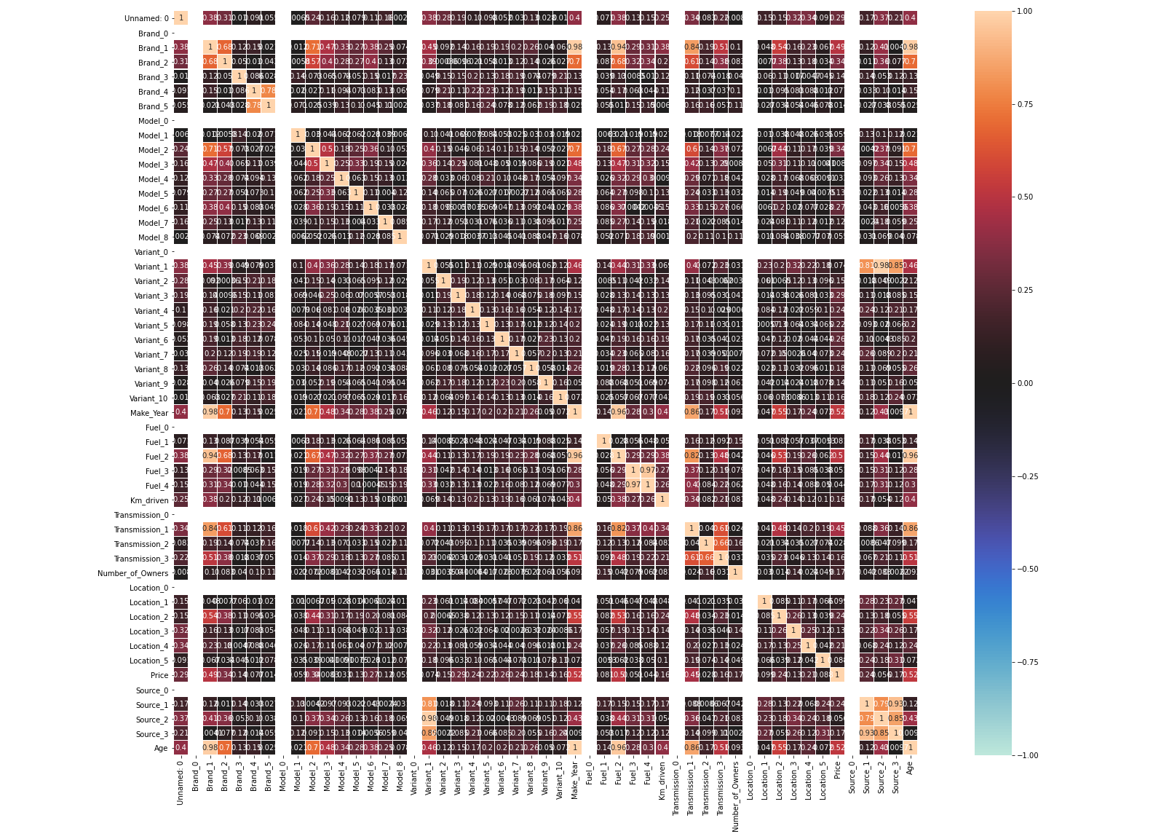
Analysis on Heat Map
The following features are highly correlated hence they are dropped from the dataset for improved accuracy of prediction.
'Make_Year'
'Source_0'
'Source_1'

Slide 13
Model Fitting and Tuning
4

Slide 14
Performance of Models
S. No. | Model Name | MSE
1. | Linear Regression | 156314
2. | Lasso | 156308
3. | Ridge | 156239
4. | KNN | 220941
5. | Decision Tree | 163920
6. | Random Forest | 117846
7. | Ada Boost | 167328
8. | Gradient Boost | 138487
9. | XG Boost | 121599

Slide 15
Performance of Models after Tuning
S. No. | Model Name | Score
1. | Decision Tree | 0.56
2. | XG Boost | 0.712
3. | Random Forest | 0.700
4. | Gradient Boost | 0.641

Slide 16
Conclusion

Slide 17
Based on our analysis the XG Boost Regressor predicted the house of properties.
We cleaned the data, performed EDA and successfully trained a model and tuned the hyper parameters to predict the price of properties based on the features and dataset available with us. The XG Boost Regressor proved to be the best model in terms of score and performance.
Score – 0.712
MAE – 64535
RMSE – 118563
Hyper Parameters – {max_depth=20, learning_rate=0.2, min_child_weight=9, gamma=0.3, colsample_bytree=0.5}

